Slide 1
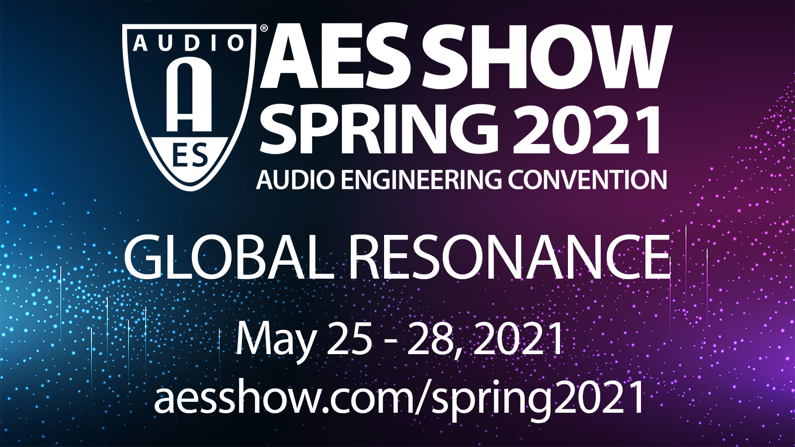

Slide 2
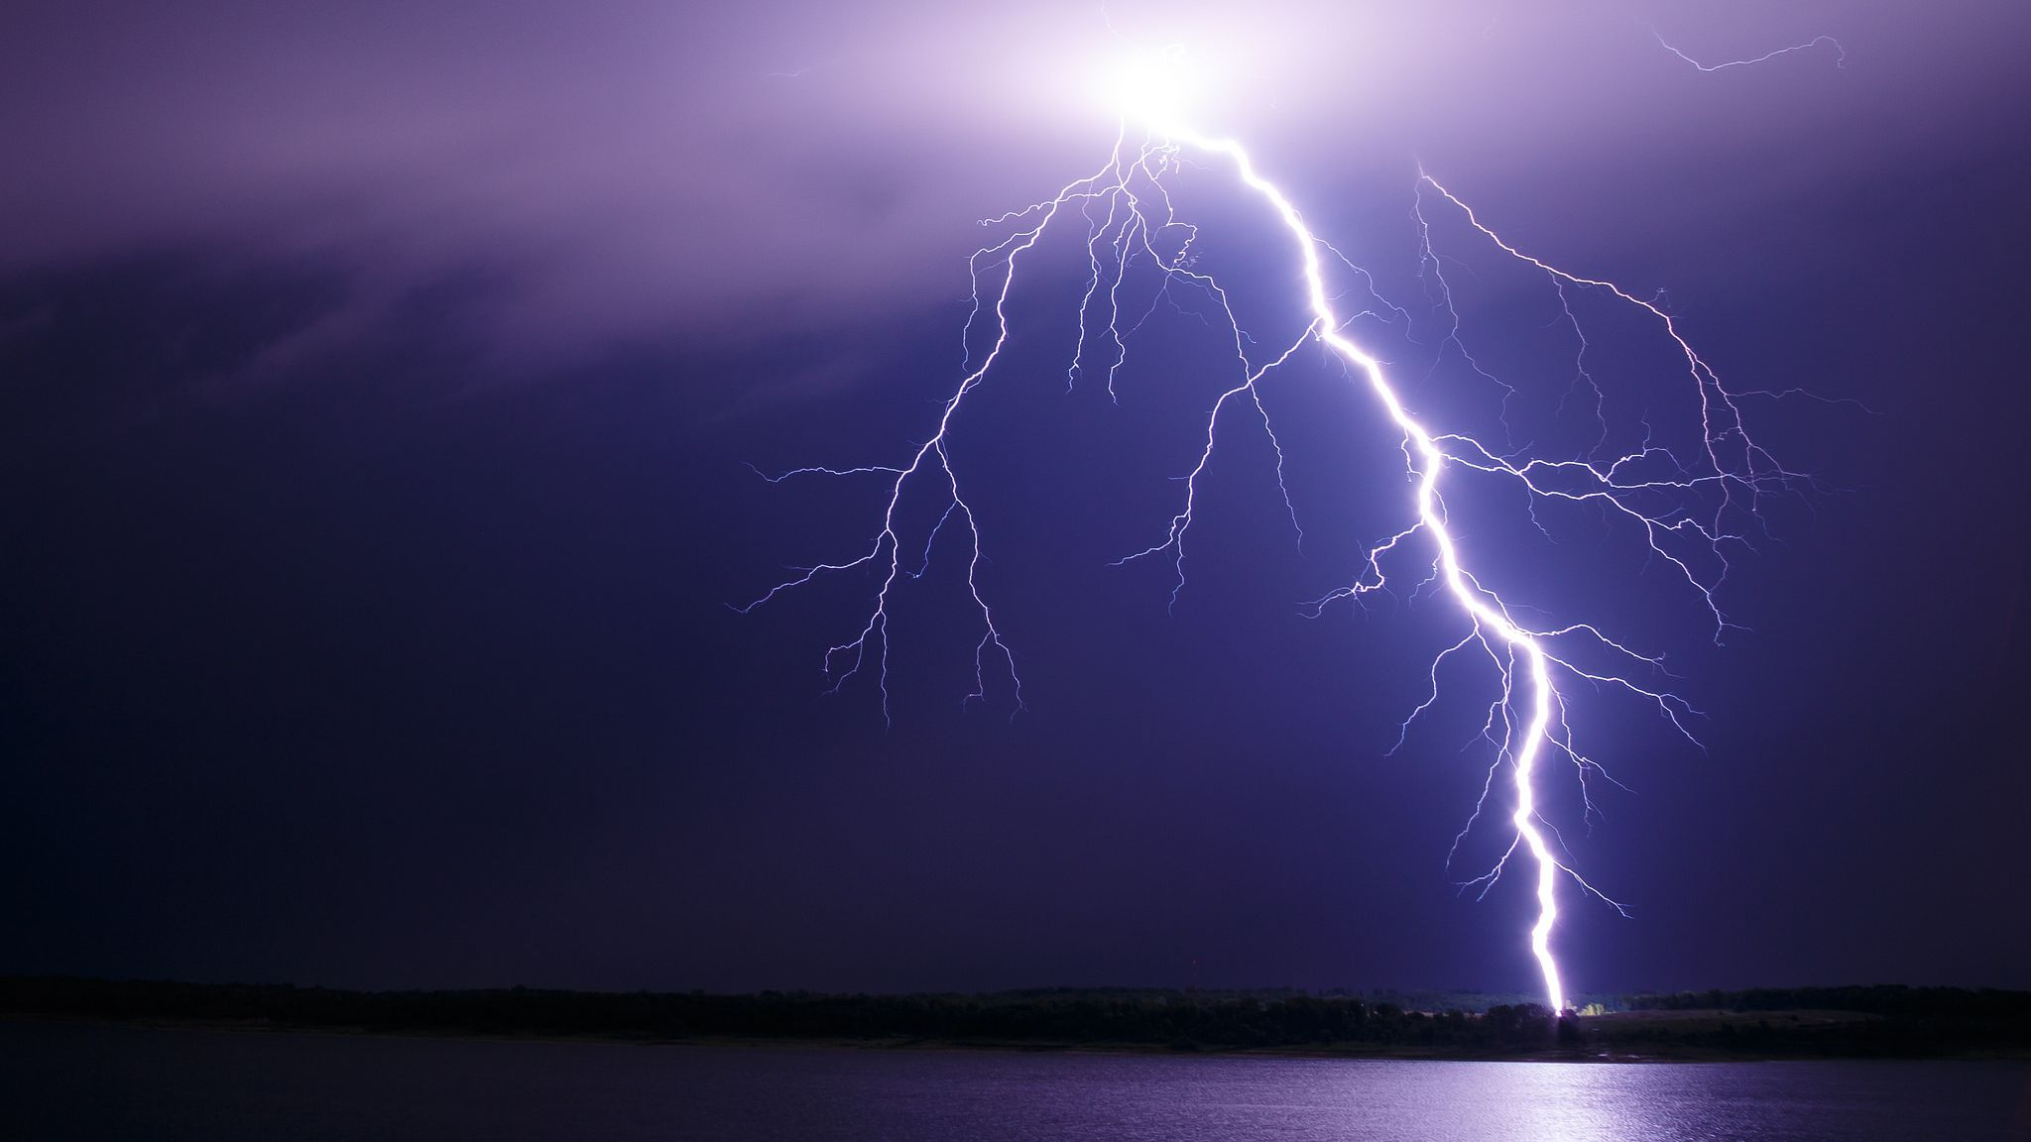
A comparative perceptual evaluation of thunder synthesis techniques
Josh Reiss, Hazar Tez and Rod Selfridge

Slide 3
Thunder!
Widely used in game, film and virtual reality sound design
Simulation also aids understanding of the underlying physics
Many models of thunder proposed
But no formal perceptual evaluation… yet

Slide 4
The physics of thunder
Lightning
short duration, high voltage electrical discharge between a cloud and ground
consista of segments, tortuosity of the lightning channel, ~ 5 to 70 meters long
When discharge happens, shock wave expands at roughly 3000 m/s
shock wave leaves behind weak shock wave caused by rapidly heating air in the lightning channel, the thunder clap
Also hear thunder rumble, often for many seconds, as well as multiple strikes
Relates to tortuosity, reflections, sound dissipation through air

Slide 5
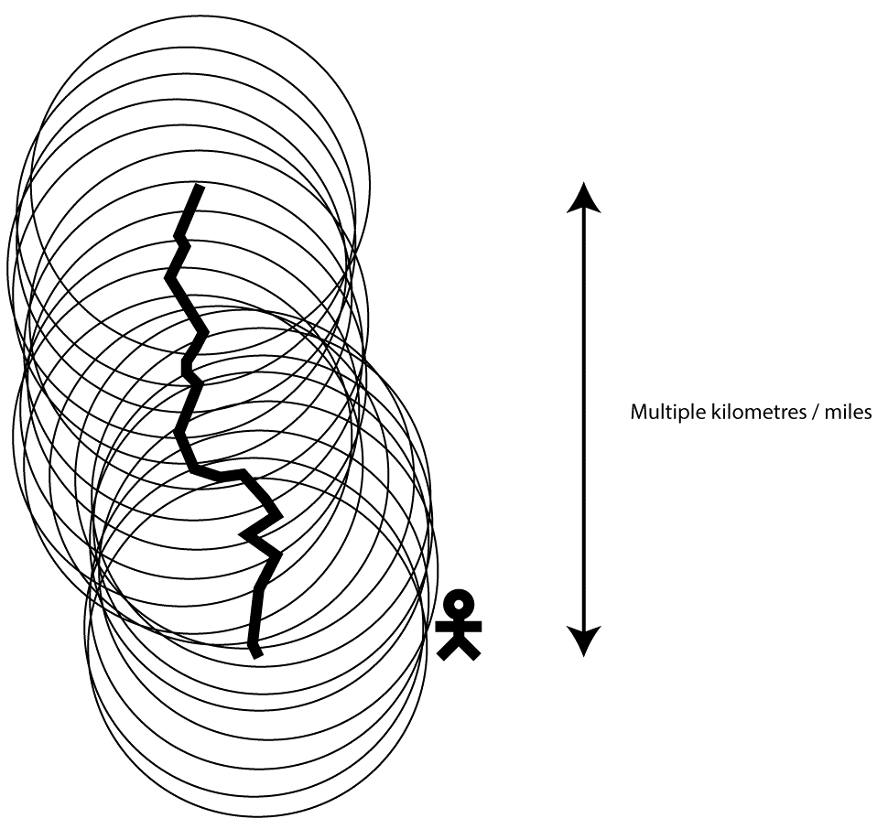
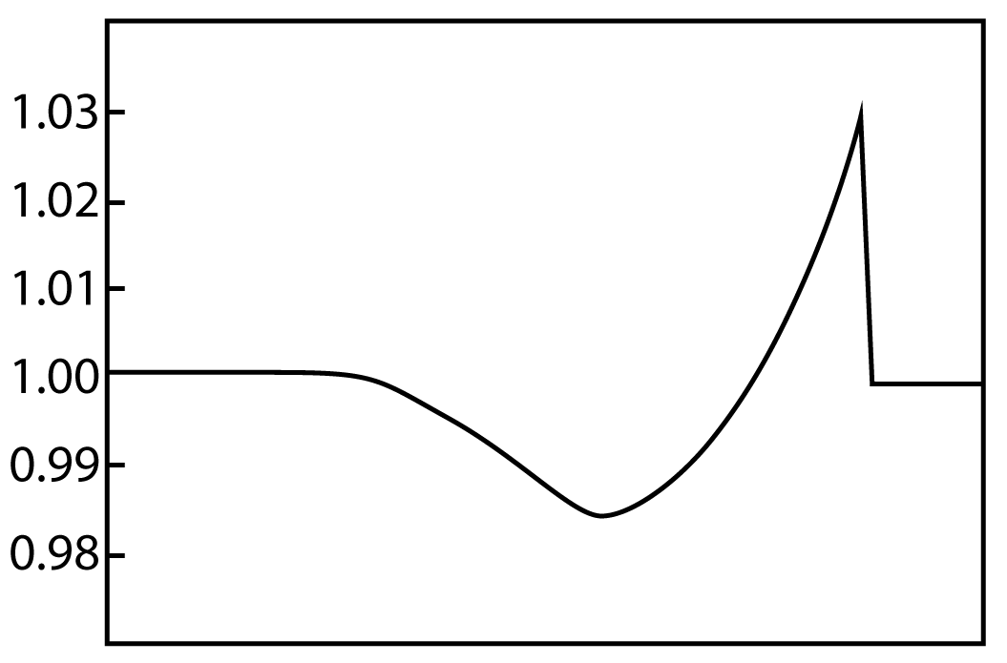
Modeling – Huygens principle
Brode pulse

Slide 6
Modeling – WM Wave
Only the kinks where line segments intersect matter

Slide 7
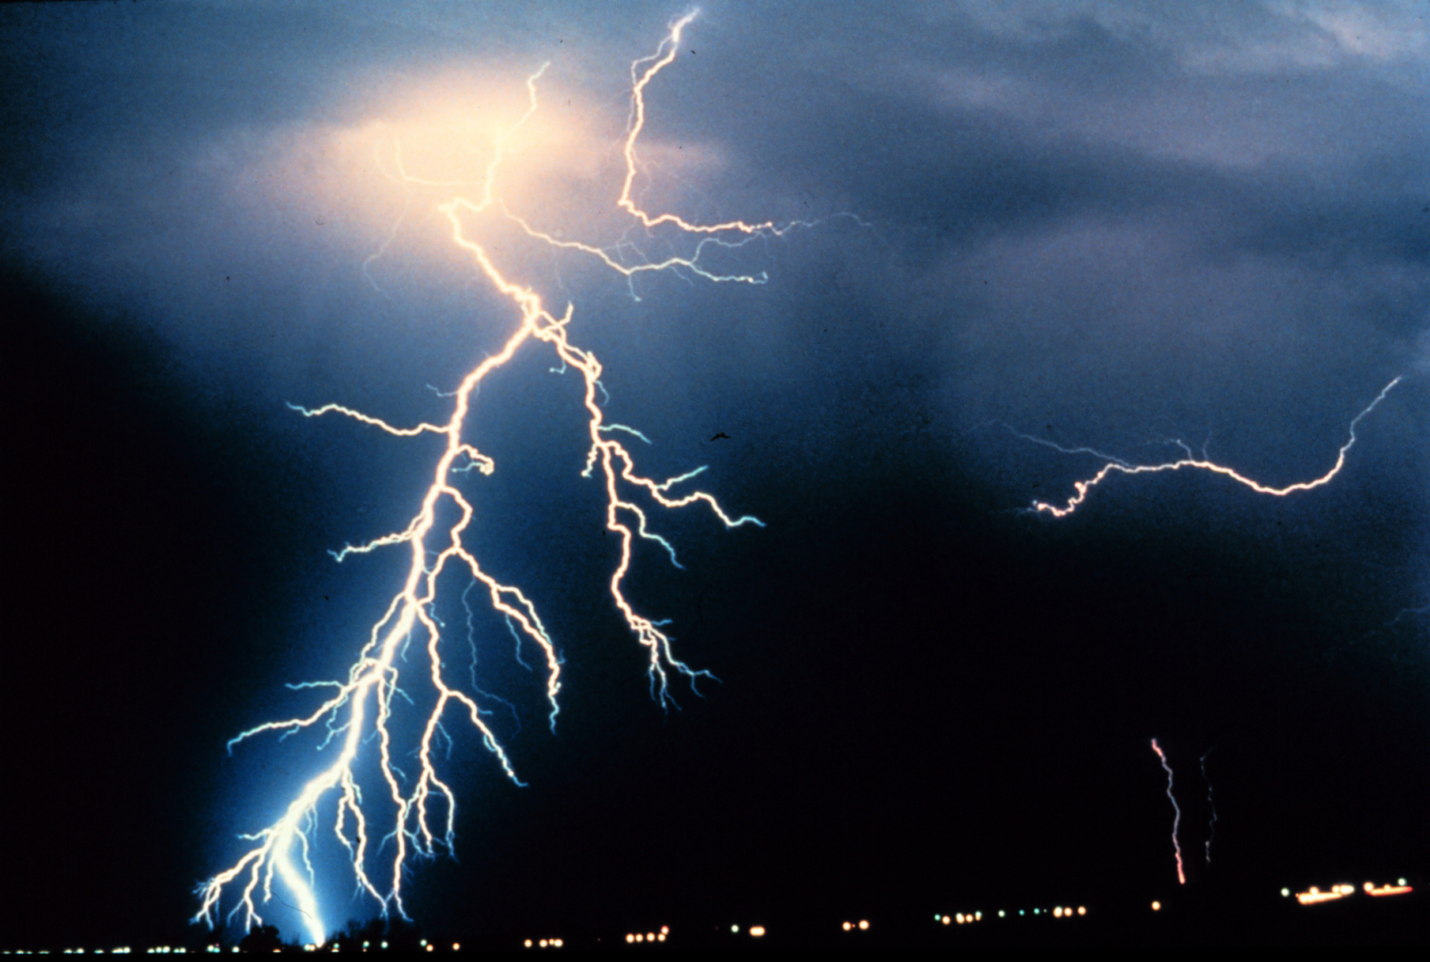
Other aspects
Lightning
Branching
In-cloud lightning ‘the halo’
Multistrike
Distance attenuation
Filtering through air
Reflections
Spatial rendering

Slide 8
The models
Author | Approach | Method | Available | Platform | Real-time | Lightning
Brooks | Signal-based | Physically-inspired | Yes | Max MSP | Yes | No
Cundangan |  |  | Yes | Max/Unity | Yes | 3D
Farnell |  |  | Yes | PureData | Yes | No
Selfridge |  |  | Yes | JavaScript | Yes | 2D
Unknown | Physical | WM Wave | Yes | Matlab | ? | 3D
Glassner |  |  | No | ? | ? | 3D
Blanco |  |  | On request | Matlab | No | 2D
Dunkin |  |  | No | Matlab | No | 3D
Saksela |  | Brode waves | Yes | JavaScript | No | 3D

Slide 9
The models
Author | Approach | Method | Available | Platform | Real-time | Lightning
Brooks | Signal-based | Physically-inspired | Yes | Max MSP | Yes | No
Cundangan |  |  | Yes | Max/Unity | Yes | 3D
Farnell |  |  | Yes | PureData | Yes | No
Selfridge |  |  | Yes | JavaScript | Yes | 2D
Unknown | Physical | WM Wave | Yes | Matlab | ? | 3D
Glassner |  |  | No | ? | ? | 3D
Blanco |  |  | On request | Matlab | No | 2D
Dunkin |  |  | No | Matlab | No | 3D
Saksela |  | Brode waves | Yes | JavaScript | No | 3D
See paper for samples & links

Slide 10
Listening test
Multistimulus paradigm used to present user with continuous scale
Very unrealistic - Quite unrealistic - Quite realistic - Very realistic
Samples from 5 synthesis techniques & recorded thunder sample from BBC sound effects archive
All samples set to same loudness & 44.1 kHz sample rate
51 people, all experienced with audio, rated samples in terms of realism
Samples can be played and dragged across the scale to rate them
Participants did test remotely during Coronavirus lockdown, so under varying listening conditions

Slide 11
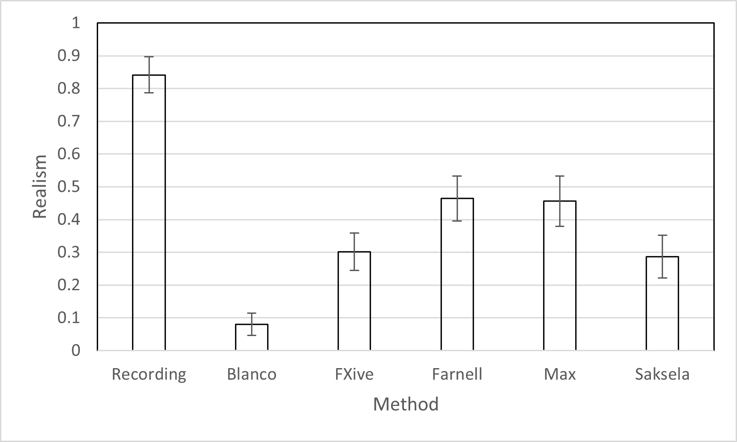
Results
Recording Blanco Selfridge Farnell Brooks Saksela

Slide 12
Conclusions
Results showed that none of the models were close to the recording in terms of realism
signal-based models slightly outperformed the physical models
highlights need for comparative perceptual evaluation in sound synthesis
identifies limitations of current thunder simulation approaches

Slide 13

Future work – the ultimate model
Combine best features of existing approaches
include electrical discharges within cloud, branches off the main branch
more accurately represent the N-wave
represent geometry in 3D
distance attenuation should be frequency dependent
include natural reverberation of an outdoor environment
Stereo panning or HRTF to position sounds correctly around listener
Make real-time
Computation isn’t the issue

